Slide 1



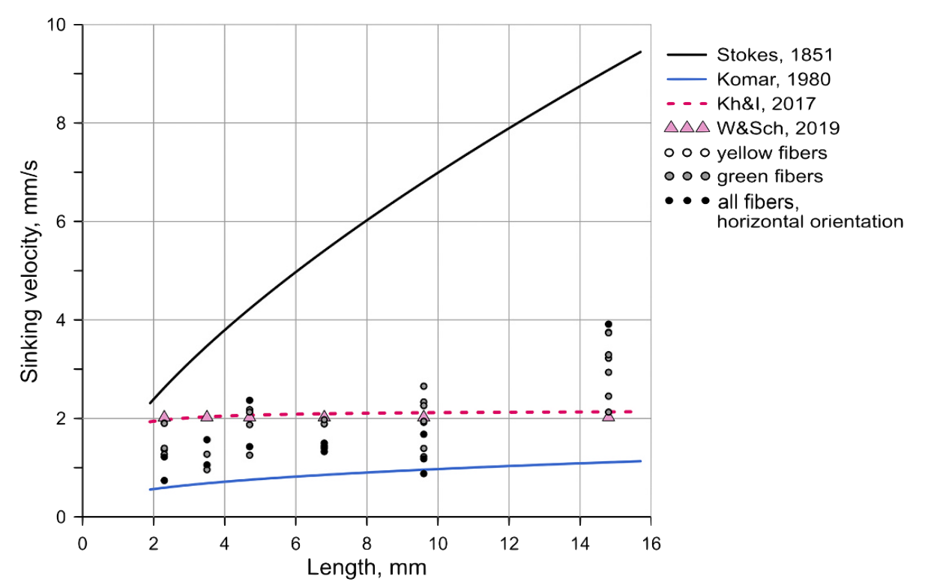
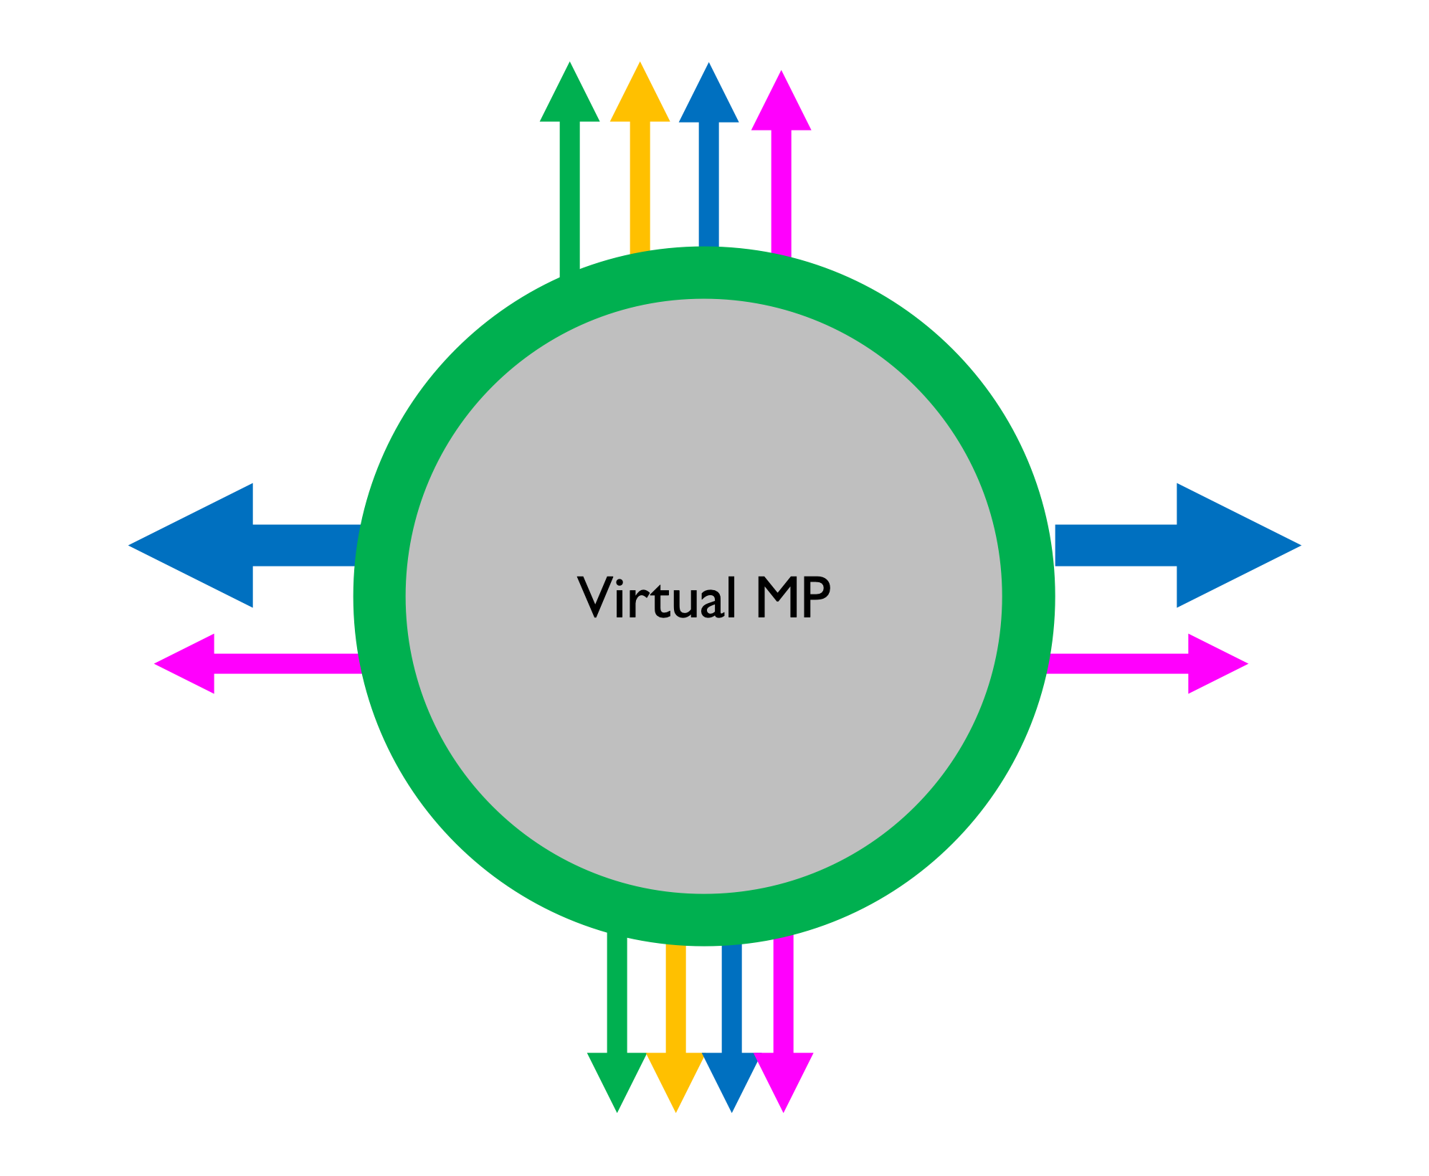
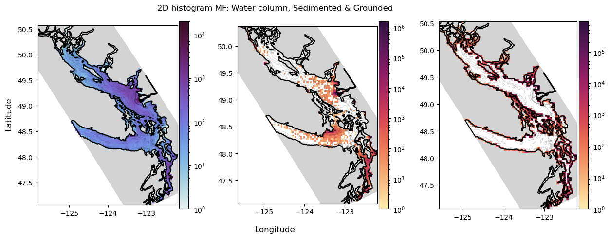
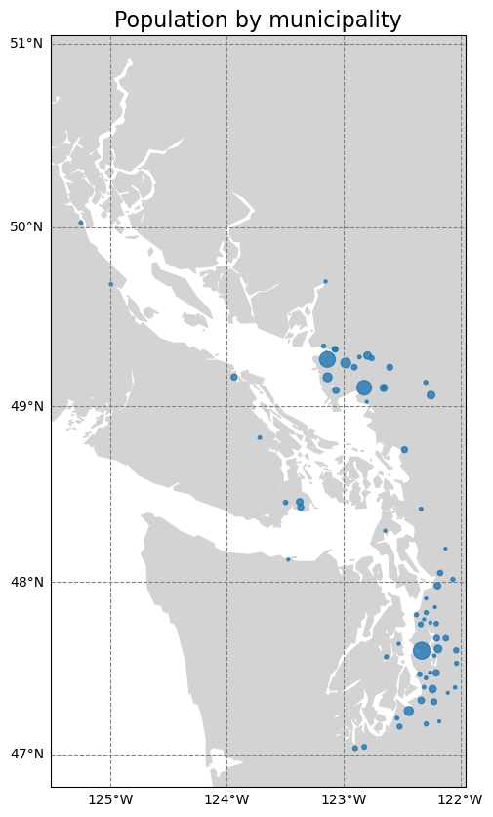
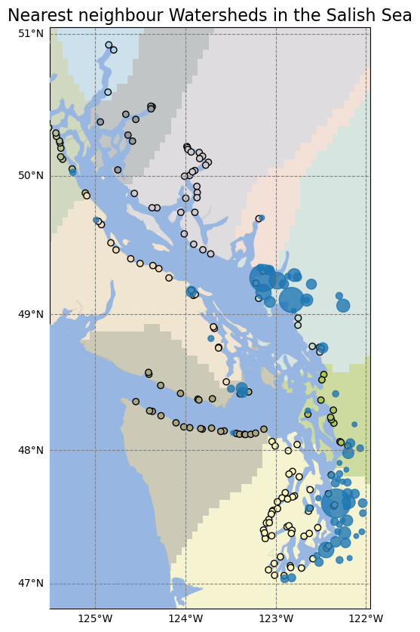
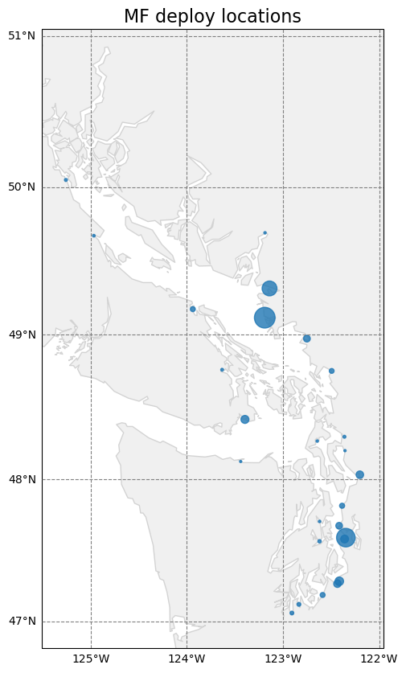
Modeling PET microfibres dynamics in the Salish Sea.
Jose Valentí, Susan E. Allen.
Models
From perfect tracers to Microplastics
Surface estimations and Accumulation
Figure 9: Average surface concentrations of polyester microfibres estimated from a 150-day OceanParcels simulation. Figure 10: 2D histogram showing accumulative counts of polyester microfibres considered sedimented after a 150-day simulation.
Khatmullina and Chubarenko, (2021)
Figure 6: Observed settling velocities of polyester fibres with different lengths in experiment by Khatmullina and Chubarenko, (2021) marked by grey and black circles; settling velocity estimated using Stokes equation marked by black solid line; settling velocity estimated using Komar equation marked by blue solid line; settling velocity estimated using Waldschläger and Schüttrumpf (2019) proposed equation marked by pink dashed line. Figure 7: Simplified sketch showing how different processes affect the dynamics of a microplastic drifting in the water. Different colored arrows indicate the different process considered. Blue arrows indicate Advection, pink indicates turbulent mixing, orange represents buoyancy forces, and green represents biofouling.
The WAVEWATCH III Development Group, (2019)
SalishSeaCast (Soontiens et al., 2016)
Figure 1 (top left): SalishSeaCast Surface Velocities on the 1st of December 2022. Magnitude indicated by the colormap and direction by the arrows. Figure 2 (top right): WaveWatch III wave direction on the 1st of December 2022. Figure 3 (bottom right): Results from OceanParcels run after 15 days deploying neutral particles from Iona Outfall. Particle age indicated in the colorbar.
Approximating PET Sources
Ocean Parcels (Lange and van Sebille, 2017)
Beaching and Temporal Variability
References
Delandmeter, P., & Van Sebille, E. (2019). The Parcels v2. 0 Lagrangian framework: new field interpolation schemes. Geoscientific Model Development, 12(8), 3571–3584. https://doi.org/10.5194/gmd-12-3571-2019
Khatmullina, L., & Chubarenko, I. (2021). Thin synthetic fibers sinking in still and convec- tively mixing water: laboratory experiments and projection to oceanic environment. Environmental Pollution, 288, 117714. https://doi.org/10.1016/j.envpol.2021.117714
Pawlowicz, R., Hannah, C., & Rosenberger, A. (2019). Lagrangian observations of estuarine residence times, dispersion, and trapping in the Salish Sea. Estuarine, Coastal and Shelf Science, 225, 106246. https://doi.org/10.1016/j.ecss.2019.106246
Soontiens, N., Allen, S. E., Latornell, D., Le Souëf, K., Machuca, I., Paquin, J.-P., Lu, Y., Thompson, K., & Korabel, V. (2016). Storm surges in the Strait of Georgia simulated with a regional model. Atmosphere-Ocean, 54(1), 1-21. https://doi.org/10.1080/07055900.2015.1108899
The WAVEWATCH III Development Group. (2019). User manual and system documentation of WAVEWATCH III. Version 6.07. Tech. Note 333, NOAA/NWS/NCEP/MMAB, College Park, MD. https://polar.ncep.noaa.gov/waves/wavewatch/manual.v5.16.pdf
Pawlowicz et al., (2019)
Figure 8: Sources of Polyester microfibres from household laundry in the Salish Sea. (a) Municipalities with more than 20000 people inside Salish Sea watersheds. Size of the circles is proportional to the population of the municipalities. (b) River mouth locations and their watersheds in SalishSeaCast. Color indicates the different watersheds; blue circles shows the municipalities in the same way as in (a); and the circles indicate de location of the river mouths inside the model. (c) Polyester microfibers sources defined for our model. Size indicates the strength of the sources.
Special Thanks to…
Figure 4: 2D histogram showing accumulative counts of MF considered beached after a 150-day simulation. Figure 5: Time series of beaching time (time elapsed between the moment a particle enters the water and it reaches the coast) in the Salish Sea as predicted using SalishSeaCast and OceanParcels. Blue line marks the average beaching time per week. Red line shows the accumulated Fraser river discharge per week.
Email: jvalenti@eoas.ubc.ca

